Slide 1

Mobilizing computable biomedical knowledge
CBK

Slide 2
INTRODUCTION AND BACKGROUND
Motivation: The manifesto on Mobilizing Computable Biomedical Knowledge (CBK) highlights the crucial need for leveraging digital technology to improve healthcare outcomes. This presentation aims to explore the potential impact of CBK in addressing health disparities and improving access to quality healthcare worldwide.
Context and Relevance: In an era marked by rapid advancements in science and technology, the healthcare sector stands to benefit significantly from the mobilization of computable biomedical knowledge. By harnessing the power of data-driven decision-making and interoperable knowledge systems, we can revolutionize healthcare delivery, enhance patient outcomes, and promote health equity.

Slide 3
GOALS
Through this presentation, we aim to:
Understand the principles of CBK and its role in transforming healthcare.
Explore datasets related to healthcare disparities and CBK implementation.
Visualize key insights from the datasets through interactive charts and maps
Discuss the potential limitations and implications of CBK in addressing health disparities.

Slide 4
DATASETS
Health Costs Dataset
Source: Kaggle
Variables: Demographic data (age, gender, race/ethnicity), healthcare access indicators (insurance coverage, proximity to healthcare facilities), health outcomes (mortality rates, prevalence of chronic diseases).
Size: Thousands of cases, multiple variables.
Locations: Nationwide coverage, with a focus on underserved communities.
Purpose: To identify disparities in healthcare access and outcomes among different population groups.
Limitations: Data may be subject to reporting biases, limited granularity in certain variables

Slide 5
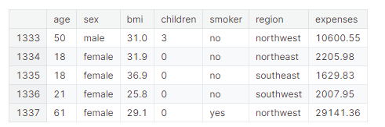
VISUALIZATIONS

Slide 6
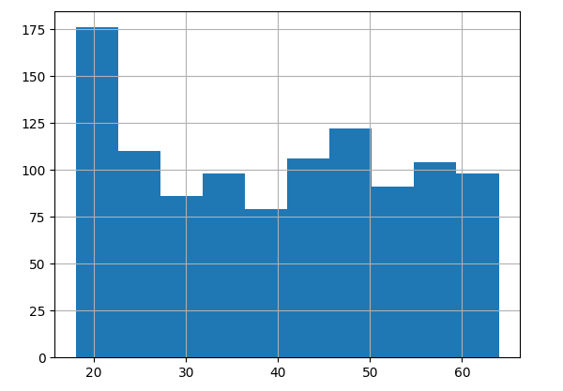
VISUALIZATION

Slide 7
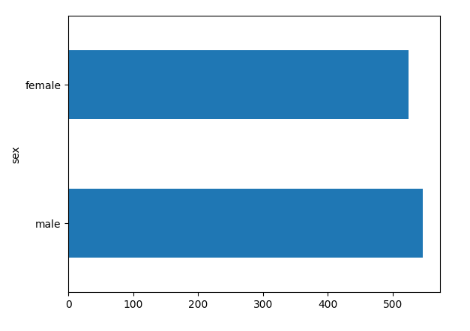
VISUALIZATION

Slide 8
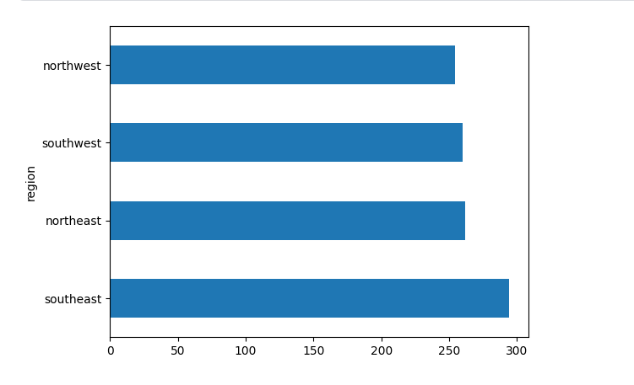
VISUALIZATION

Slide 9
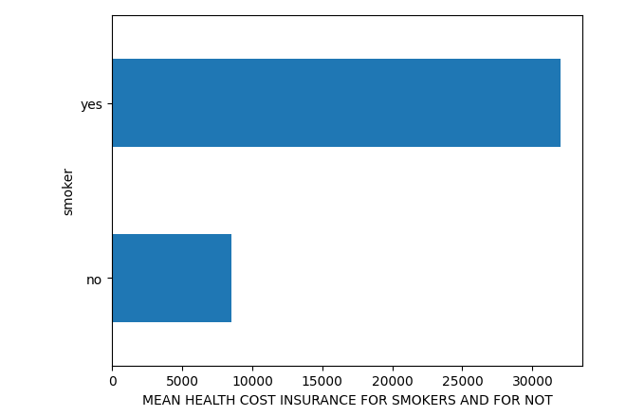
VISUALIZATION

Slide 10
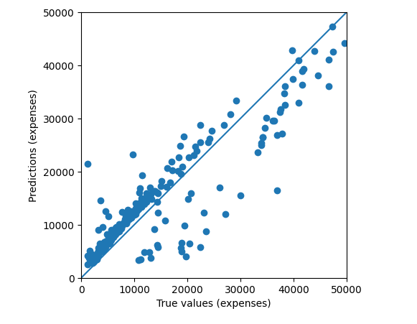
VISUALIZATION

Slide 11
STORY
The visualizations helps in the understanding of the analysis of the data.
The analysis help us predict the cost of health care given factors such age, sex, if the person is a smoker or not

Slide 12
CONCLUSION
By leveraging the power of CBK, we have the opportunity to revolutionize healthcare delivery and address disparities that have long plagued our healthcare systems. Through data-driven insights and collaborative efforts, we can strive towards a future where every individual has access to quality healthcare, regardless of their background or geographic location.

